Slide 1



Statistical methods in global NO₂ mapping
University of Utrecht, The Netherlands
Meng Lu

Slide 2
1. Introduction to NO₂ mapping and data hands-on 1 (10 mins): “getting ready” install packages, visualize data, data exploration: paired correlations, spatial dependence and scatterplot 2. Machine learning methods ensemble trees, deep convolutional neural networks hands-on 2 + break (45 mins): “machine learning methods.” R + Python (Kaggle) 3. Modelling process in practice hands-on 3 (15 mins): “modelling process” hyper-parameter optimization, bootstrapping-based cross-validation, mapping and compare spatial patterns of different predictions

Slide 3
Introduction and data
Part 1

Slide 4
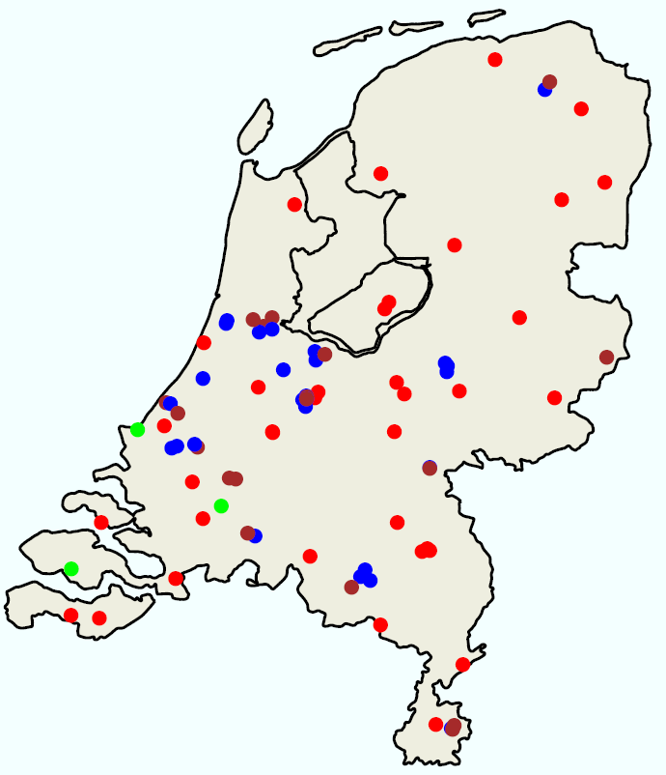
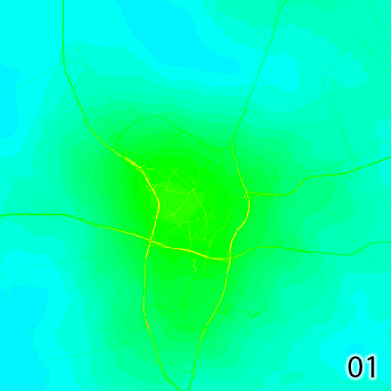

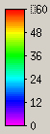
NO₂ mapping
NO₂
60
30
RURAL
TRAFFIC
0
INDUSTRY
Ground stations for NO₂ monitoring
Hour
0
5km

Slide 5
Predicting air pollution and analyzing the sources.
Land use regression (LUR)
$$y=β0+β1x1+β2x2+⋯+βnxn$$
Ground station measurements
Geospatial predictors
Development:
Integrating spatiotemporal dependency
General Additive Models
Machine learning models
Hierarchical models

Slide 6
Geospatial predictors
Road and industrial area from OpenStreetMap (vector)
Earth nightlight (500 m), VIIRS (visible infrared imaging radiometer suite)
Population (250 m)
Human settlement layers
Wind speed and temperature
ECMWF (European Centre for Medium-Range Weather Forecasts) climate reanalysis
ERA5-land
Solar radiation
Numerical model (Solargis)
Elevation: SRTM (90 m)

Slide 8
Geospatial predictors
Road and industrial area from OpenStreetMap (vector)
Earth nightlight (500 m), VIIRS (visible infrared imaging radiometer suite)
Population (250 m)
Human settlement layers
Wind speed and temperature
ECMWF (European Centre for Medium-Range Weather Forecasts) climate reanalysis
ERA5-land
Solar radiation
Numerical model (Solargis)
Elevation: SRTM (90 m)

Slide 9
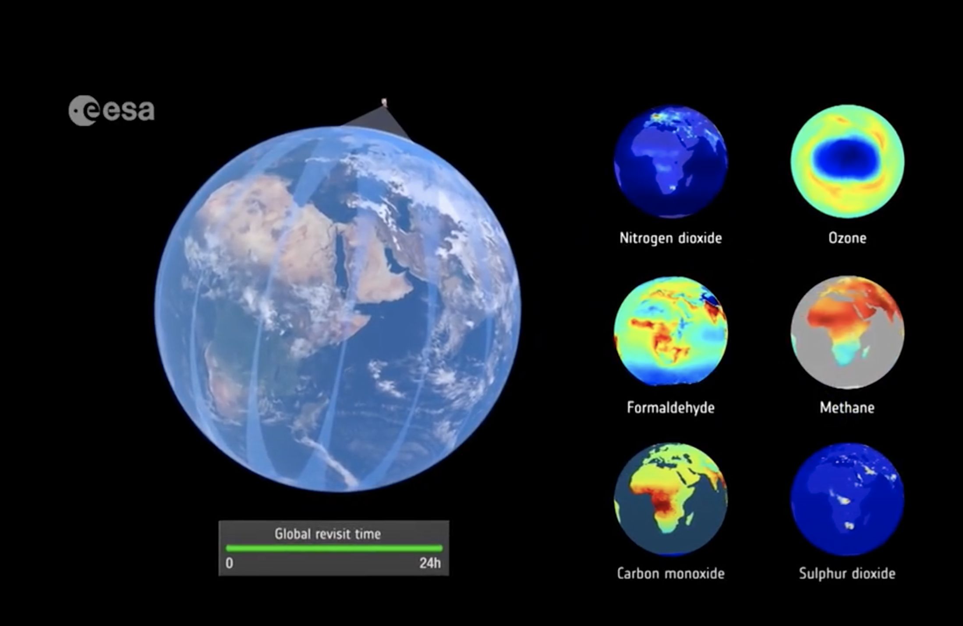

Tropomi: Sentinel 5p
(TROPOspheric Monitoring Instrument)
Launched Oct. 2017,
Resolution (NO2)
2018-2019: 7 km
Since Oct. 2019: 5.5 km
Measurements: NO₂, O₃ (7km × 28km), SO₂, methane and CO

Slide 10
Surface concentration product based on remote sensing and GEOS-CHEM (2012)
Chemical transportation models: GEOS-CHEM
Surface NO2 product made using GEOS-CHEM together with GOME, SCIAMACHY, and GOME-2 satellite instruments. http://fizz.phys.dal.ca/~atmos/martin/?page_id=232
Geddes, J. A., R.V. Martin, B. L. Boys, and A. van Donkelaar, Long-term trends worldwide in ambient NO2 concentrations inferred from satellite observations for exposure assessment, Environ. Health Perspec., DOI:10.1289/ehp.1409567, 2015

Slide 11

Ground monitor Data: OpenAQ
(2017)

Slide 12
Hands-on 1: Setup and data visualization
In the folder R_scripts
Data_visualize/Openaq.Rmd:
query station measurements from OpenAQ API
Data_visualize/ Plot_RS.Rmd:
visualize TROPOMI, OMI satellite measurements, and the remote sensing-based surface concentration product.
Introduction/GeoHub2020.Rmd:
run the chunks till “modelling” for data exploration

Slide 13
Machine learning
Part 2
1940s 1950s 1970s – 1980s, 1990s 1997 2006
Walter Pitts Turing test AI winter boosting, Deep Blue, IBM LSTM Deep learning
chess Jeopardy

Slide 14



Statistical learning --Statistical modelling and uncertainty

Slide 15

Gaussian processes for machine learning

Slide 16
Online course:
Standford
MIT
Coursera

Slide 17
Decision and regression trees
Features:
Non-parametric
Different kinds of variables
Redundant variables are ignored
Handle missing data
Small trees are easy to interpret
A regression tree
population
Hungry
> 1000/km²
yes
< 1000/km²
no
10.0
µg/m3
Traffic count
Do sports
Local food
> 500/hr
Yes
< 500/hr
No
22.5 µg/m3
20.0
µg/m3
sausage
Japanese food

Slide 18
Ensemble trees
Bagging
Random forest
Boosting
Dominance
Boosting > Randomforest > bagging > single tree

Slide 19
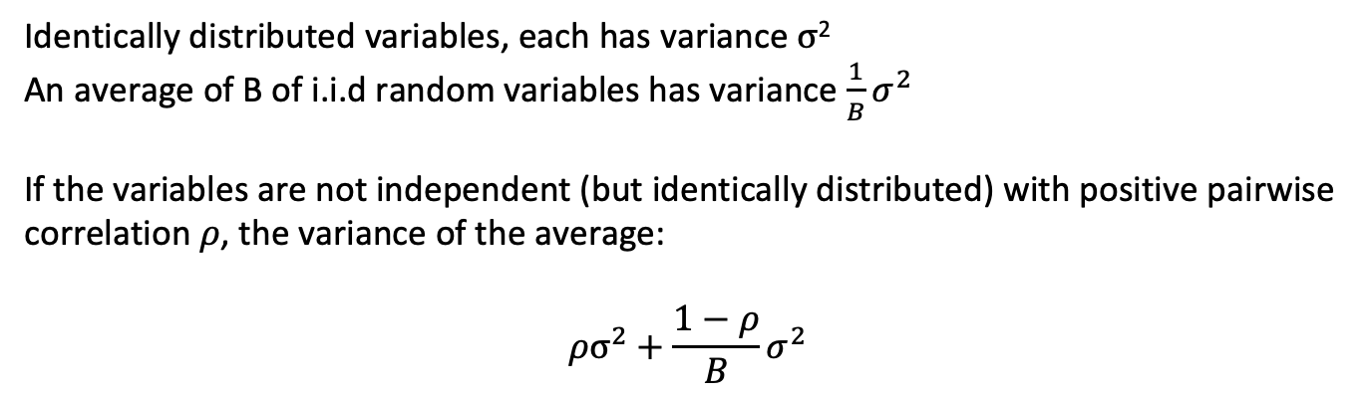
Random forest
Variance reduction
Identically distributed variables, each has variance $σ$²
An average of B of i.i.d random variables has variance $\frac{1}{B}σ^{2}$
If the variables are not independent (but identically distributed) with positive pairwise correlation$ρ$, the variance of the average:
$${ρσ}^{2}+\frac{1−ρ}{B}σ^{2}$$
“the more uncorrelated, the more you bringing down the variance”.
(tunning parameter: number of trees, tree depth)

Slide 20
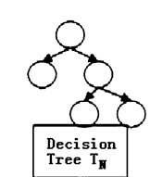
Random forest
For each tree:
Bootstraping sample D* from the training data D
Draw m* variables randomly from all variables m, pick the best split-point (variable), split the node.
Limitation:
Bias towarding variables with many splits or missing variables, does not assess uncertainty
Variations:
Recursive partition trees:
Hypothesis testing of dependency between variables and resursively fitting the splitting weight
Baysian based sampling and variable selection:
Baysian framework for 1 and 2
Quantile random forest:
Estimate quantiles (beyond the conditional mean)

Slide 21
Random forest
Hyperparameters:
Number of trees
Number of variables
Minimum observations at the leaf (terminal) node.
R_scripts/Introduction/shiny_randomforest/app.R

Slide 22
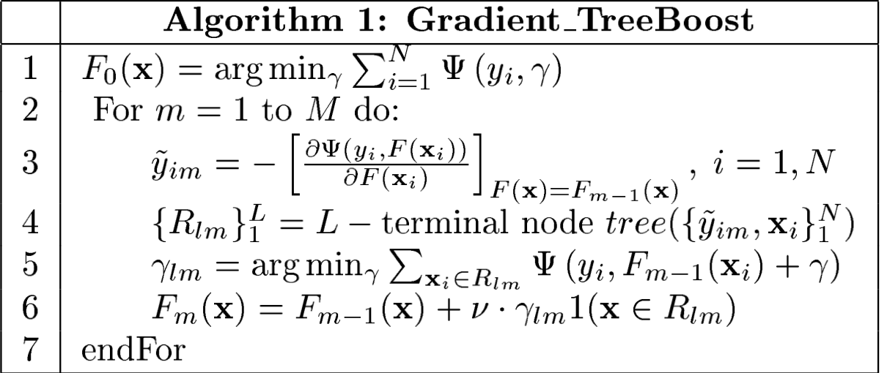
Gradient Boosting
-- Reweight based on the previous trees, stage-wise fitting
Each successive tree is built for the prediction residuals of the preceding tree in an adaptive way to reduce bias.
.
Caculate the gradient
Fit a tree
Calculate residuals
Update the approximation
approach the gradient of the loss function (e.g. binomial, logistic, poison) by trees.
Each consecutive tree is built for the prediction residuals (from all preceding trees) of an independently drawn random sample

Slide 23

Learning Rate
Stochastic Gradient Boosting
Each consecutive tree is built for the prediction residuals (from all preceding trees) of an independently drawn random sample

Slide 24
XGBoost
Exteme gradient boosting
Idea
Not only impurity, but also model complexity
obj(θ) = L(θ) + Ω(θ)
Features
Parallel computation
Objective function includes model complexity
Support dense and sparse matrix
Can costomize objective fucntions

Slide 25
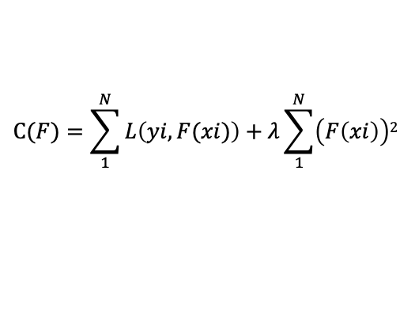
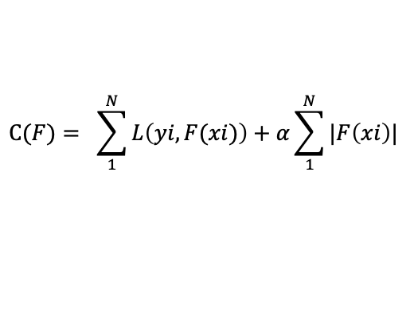
Control overfitting: model complexity
Gamma: only add nodes if the “gain” is larger than a certain value.
Alpha: Lasso (L1 norm) regularization on values of the terminal nodes
Lambda: Ridge (L2 norm) regularization on values of the terminal nodes
$$C(F)= \sum_{1}^{N}{L\left(yi, F(xi)\right)+α\sum_{1}^{N}{|F\left(xi\right)|} }$$
$$C(F)=\sum_{1}^{N}{L\left(yi, F(xi)\right)+λ\sum_{1}^{N}{\left(F\left(xi\right)\right)2} }$$

Slide 26
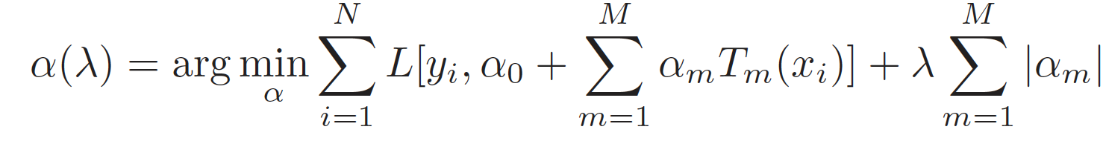
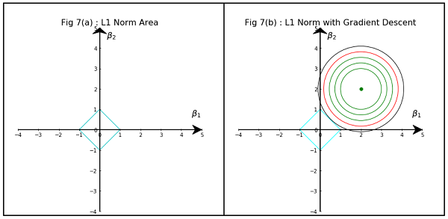
Control overfitting: Post-processing
Aggregate trees using Lasso

Slide 27
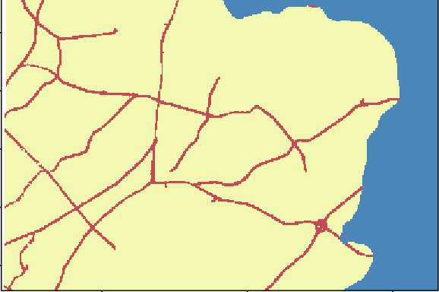
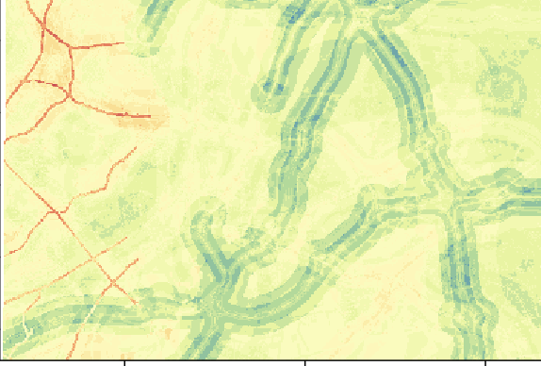
Hands-on 2 (1)
R_scripts/Introduction/GeoHub2020.Rmd:
Shiny apps:
R_scripts/Introduction/shiny_randomforest/app.r
R_scripts/Introduction/shiny_xgboost/app.r
1 tree
100 trees
https://lumeng0312.shinyapps.io/xgboost/?_ga=2.179522658.79817579.1592385947-986486774.1592216474

Slide 28
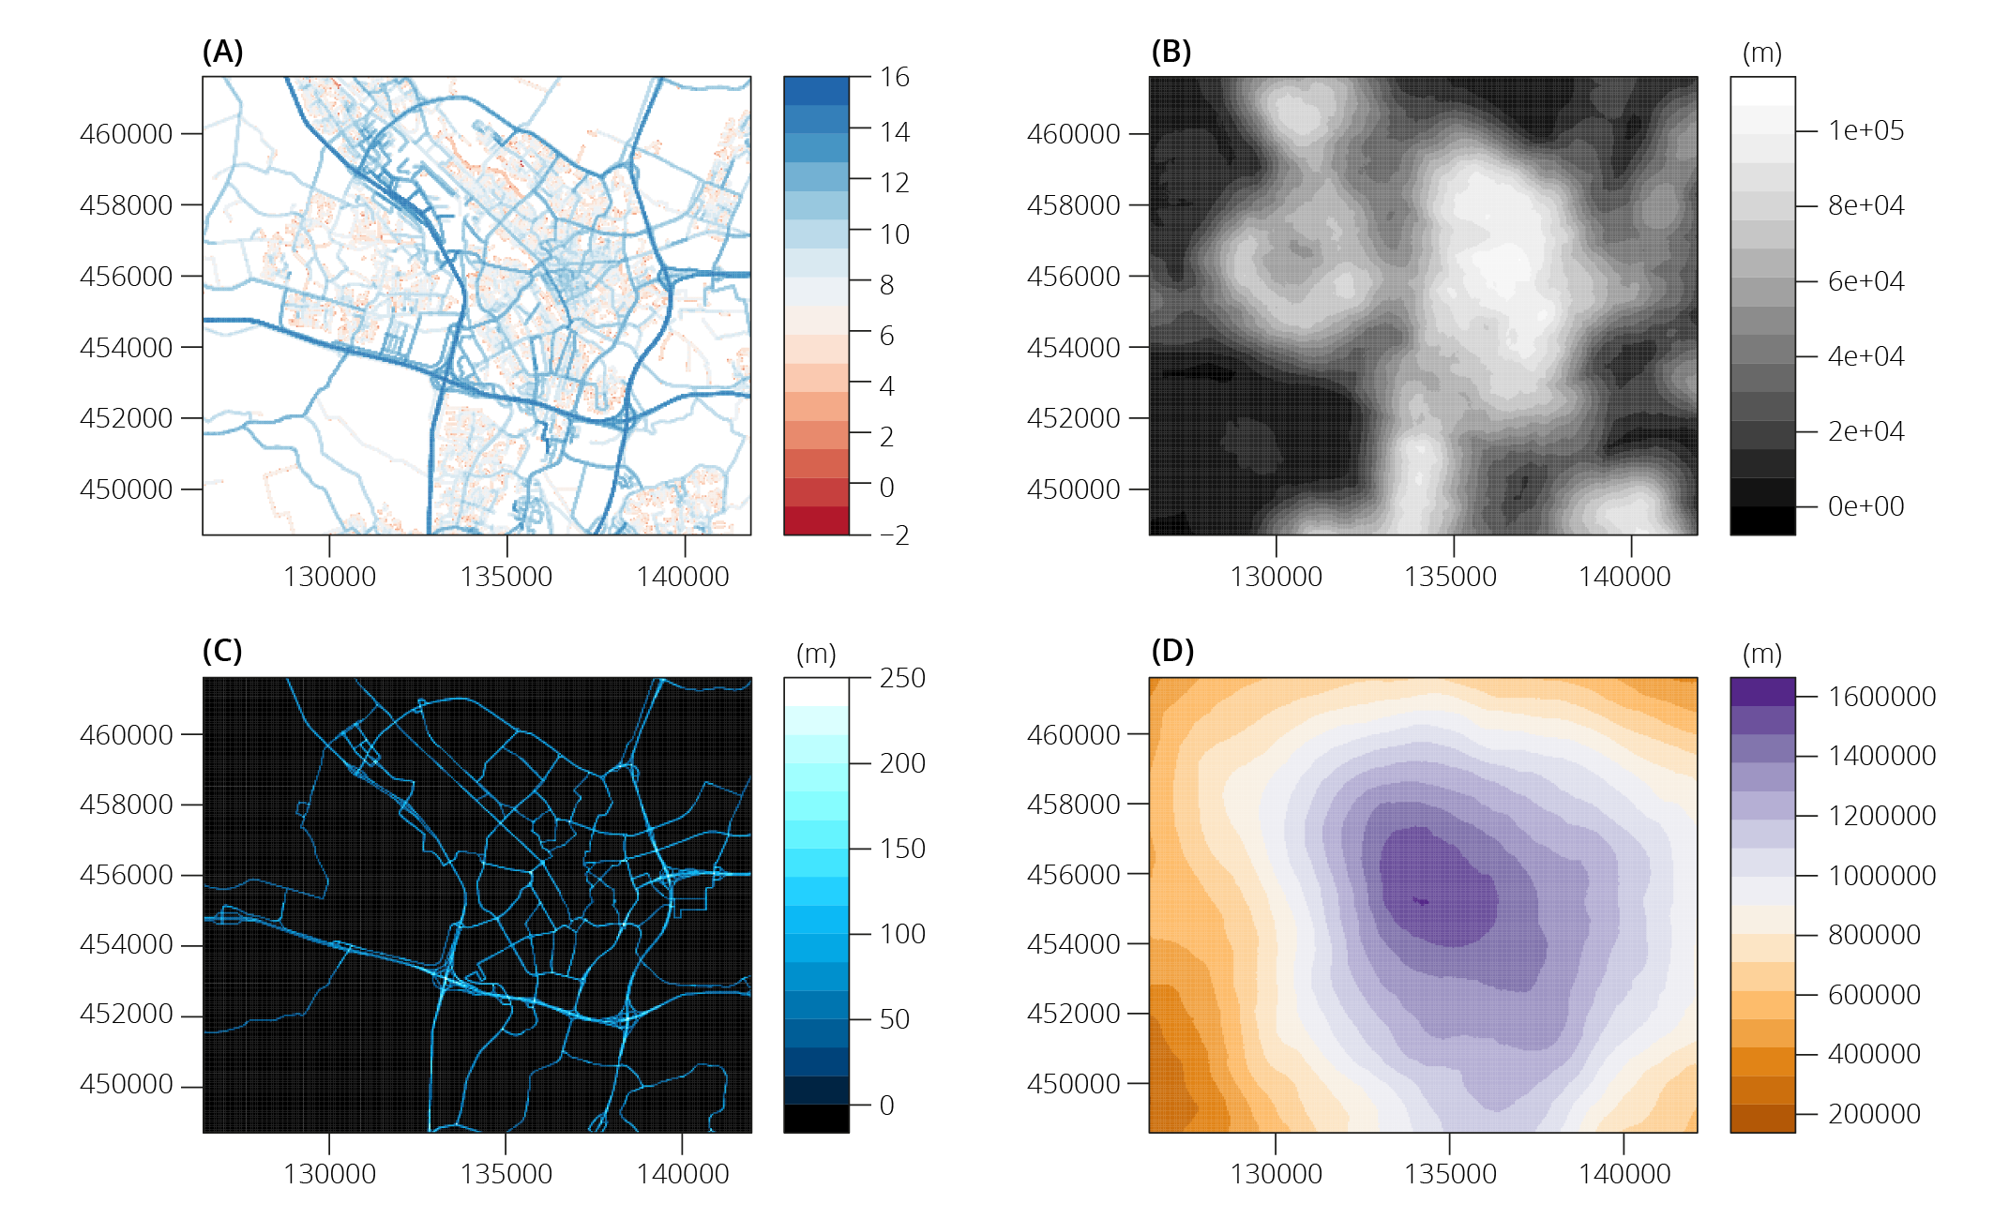
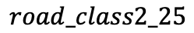
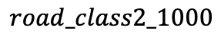
Automatic feature extraction
$$road_class2_25$$
$$road_class2_1000$$
Notes:
x

Slide 29
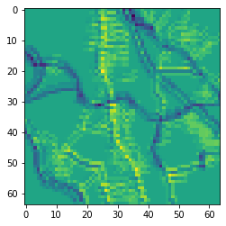
Automatic feature extraction
Road length within a buffer
Transportation networks

Slide 30
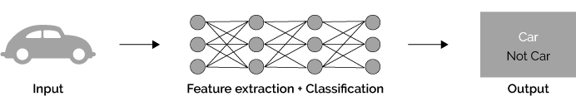
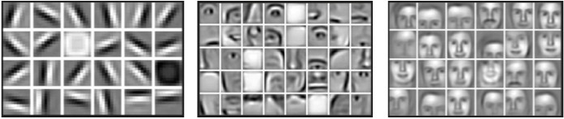
Deep Learning

Slide 31
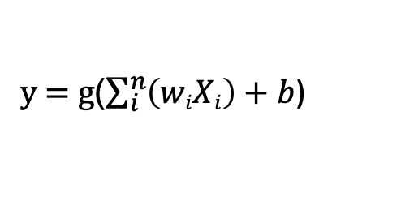
Deep learning: a neuron
sigmoid
A single neuron: perceptron
Bias b
x₁
w₁
x₂
w₂
sum
g()
y
w_{m}
Activation function
x_{m}
y = g($\sum_{i}^{n}{\left(wiXi\right)+b}$)

Slide 32
Deep learning: neural networks

Slide 33
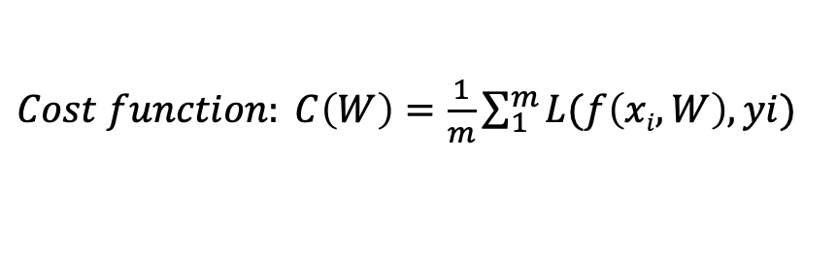
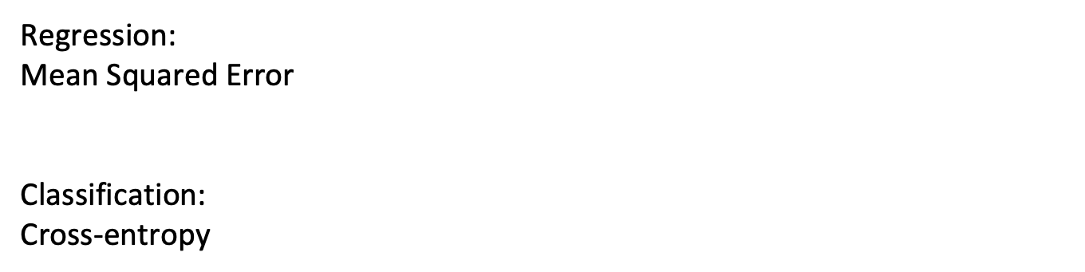
Learning: optimizing the loss
$Cost function: C\left(W\right)=\frac{1}{m}\sum_{1}^{m}{L(f\left(xi, W\right), yi)}$
Regression:
Mean Squared Error
Classification:
Cross-entropy

Slide 34
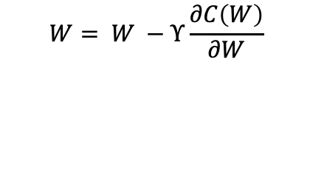
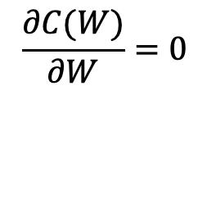
Gradient Descent
Stochastic Gradient descent
Mini-Batch Gradient descent
W
$$W= W −Υ\frac{∂C\left(W\right)}{∂W}$$
$$\frac{∂C(W)}{∂W}=0$$

Slide 35
Saddle point

Slide 36
Regularization
Ridge and Lasso paths (L1 and L2 norms)
Early stopping
Drop-out
Batch normalization

Slide 37
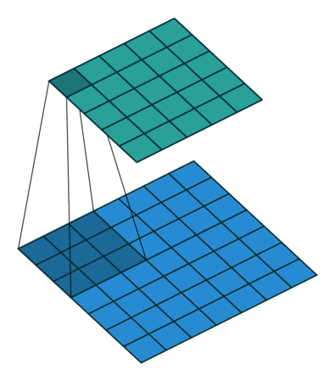
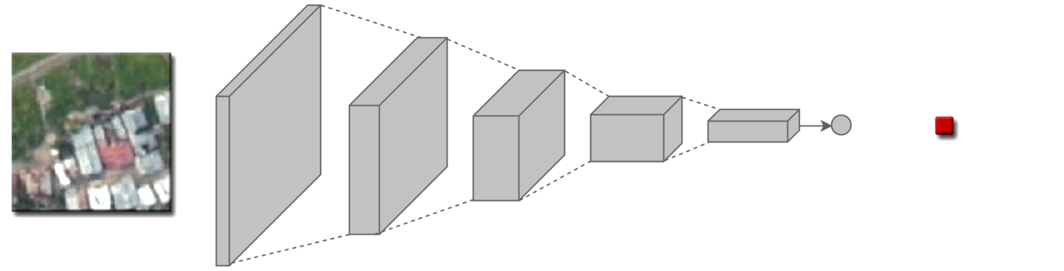
Convolutional neural networks
b
+
Convolutional filter
R_script/convolution_filter/convolution_illusrated

Slide 38
ResNet

Slide 39
Variants of ResNet

Slide 40
NO₂ mapping using concatenated neural networks
Emission-related
Background
concatenated
Dense
prediction

Slide 41
Hands-on 2 (2)
Kaggle notebook
https://www.kaggle.com/menglugeo/gap-mixed
Python/deep_learning/CNN

Slide 42
Hands-on 3: Modeling process
From R_scripts/modeling process
You can find the three R markdown files corresponding to hyper-parameter tunning, cross-validation and mapping.

Slide 43
What can the machine learning methods tell? Partial dependence plot, trees, variable importance
Part 2 (2)

Slide 44
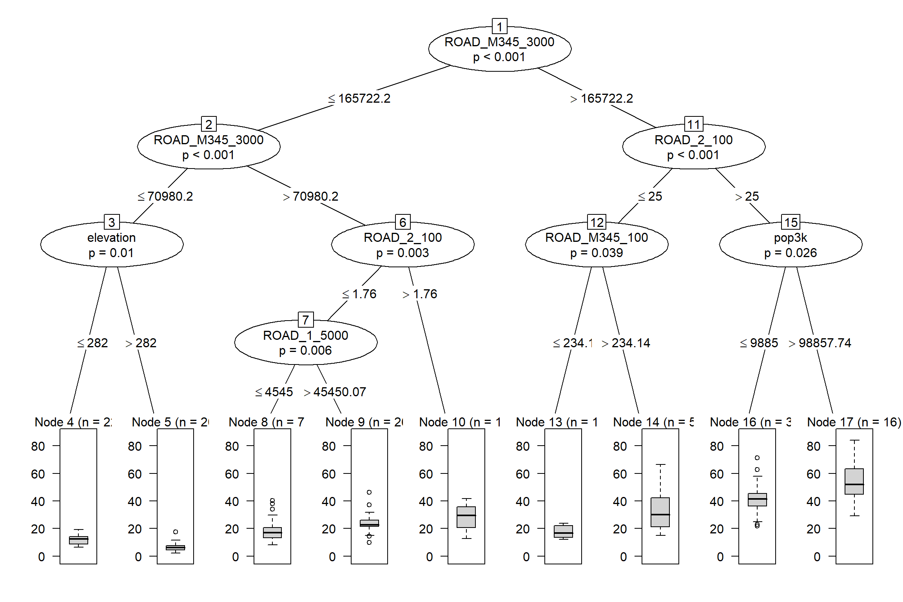
A closer look at the model
ROAD_M345: secondry
and local roads
Pop_: population
ROAD_2: primary roads
ROAD_1: highway
Visualizing a tree

Slide 45
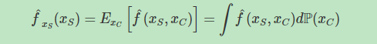
Partial dependence.
-- Shows the relationship between the target and a feature.
Xs : the features of the partial dependence function
Xc: the other features used in the machine learning model
Marginalizing the model output over the distribution of the features in set C,
Assumption: the features in C are not correlated with the features in S

Slide 46
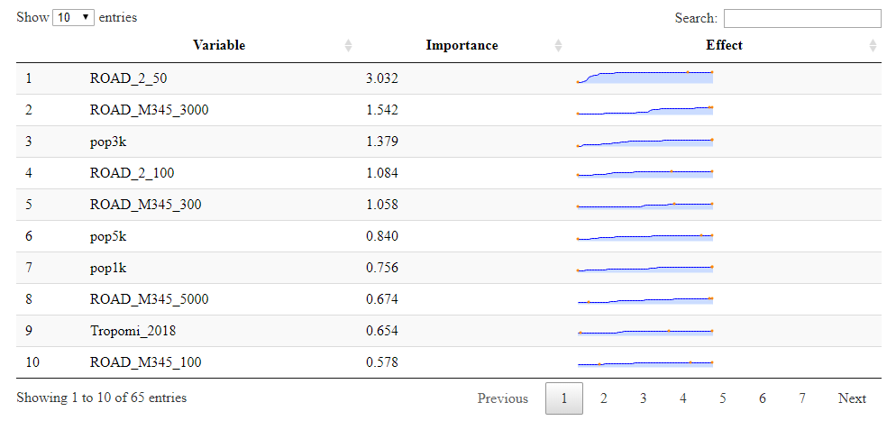

Slide 47
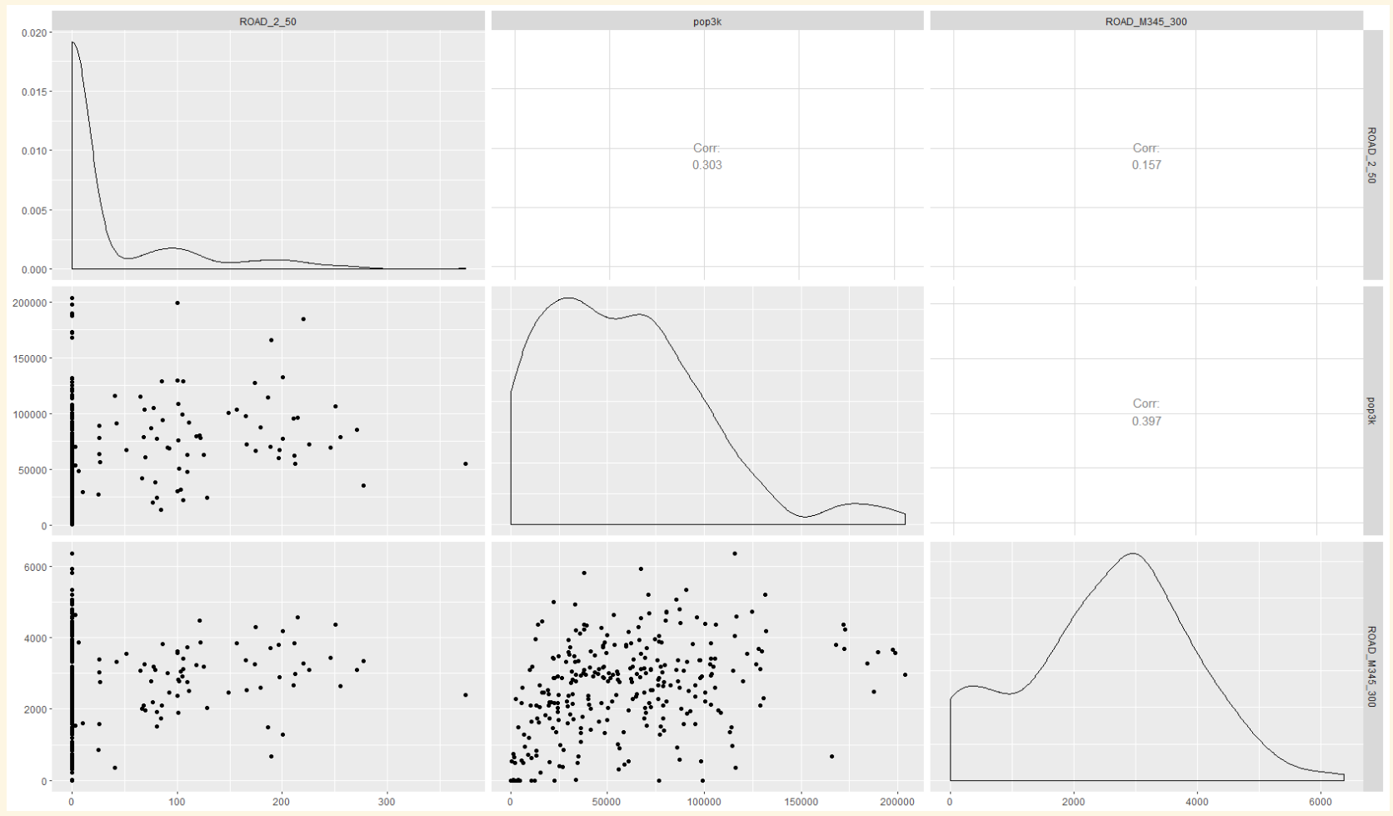
ROAD 2, 50m
Population, 3km
ROAD M345, 300m
Correlation:
0.3
Correlation:
0.16
ROAD M345, 300m
Correlation:
0.4
Population, 3km
ROAD 2, 50m
30m
120000m
5000m

Slide 48
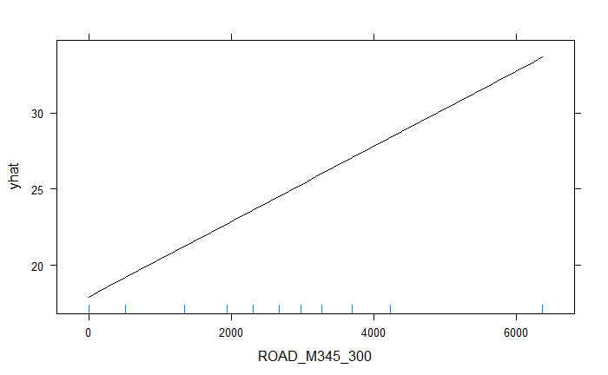
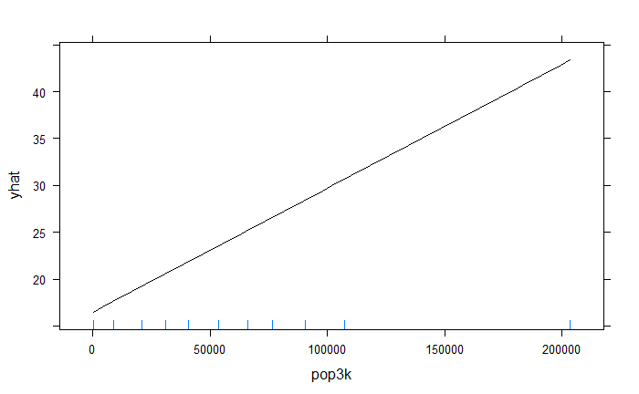
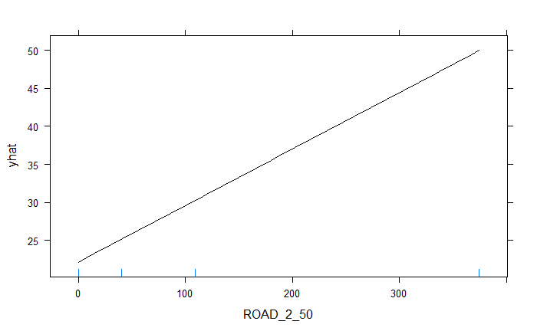
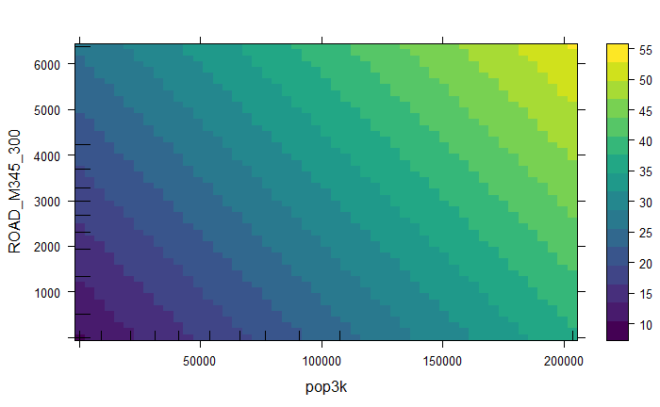
Partial dependent plots: Linear regression
ROAD M345, 300m
Population, 3km
ROAD M345, 300m
ROAD 2, 50m
Population, 3km

Slide 49
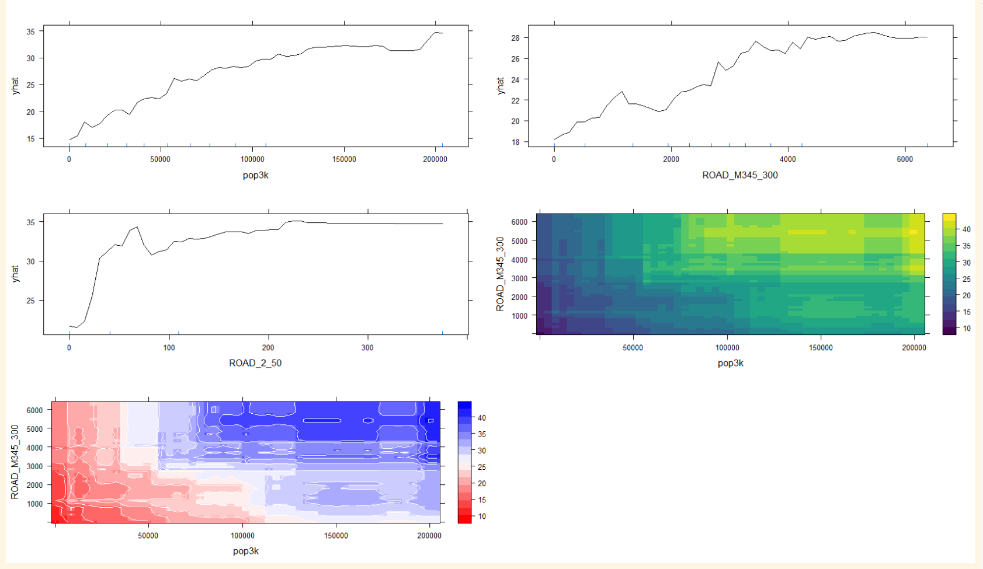
Partial dependent plots: Random forest
Population, 3km
120000m
ROAD M345, 300m
5000m
30m
ROAD M345, 300m
ROAD 2, 50m
Population, 3km
40
ROAD M345, 300m
4000
Population, 3km

Slide 50
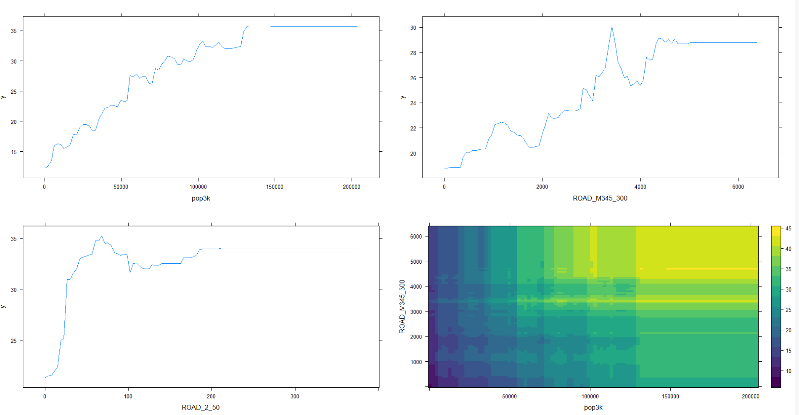
Partial dependent plots: stochastic gradient boosting
Population, 3km
120000m
ROAD M345, 300m
5000m
30m
ROAD M345, 300m
ROAD 2, 50m
Population, 3km

Slide 51
predicting and results
Part 3

Slide 52
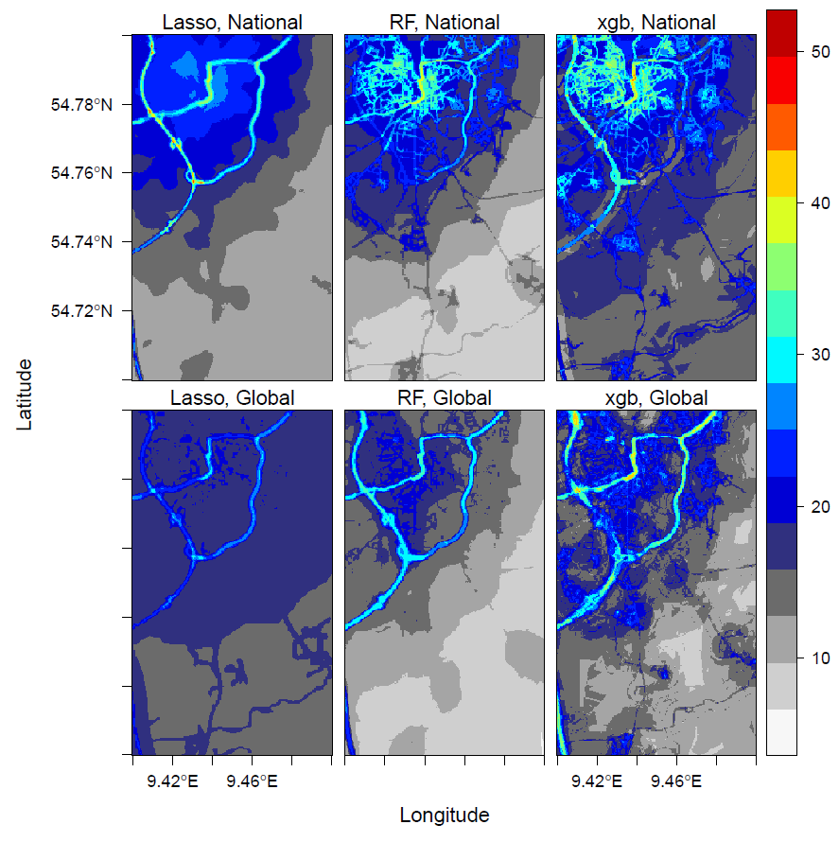
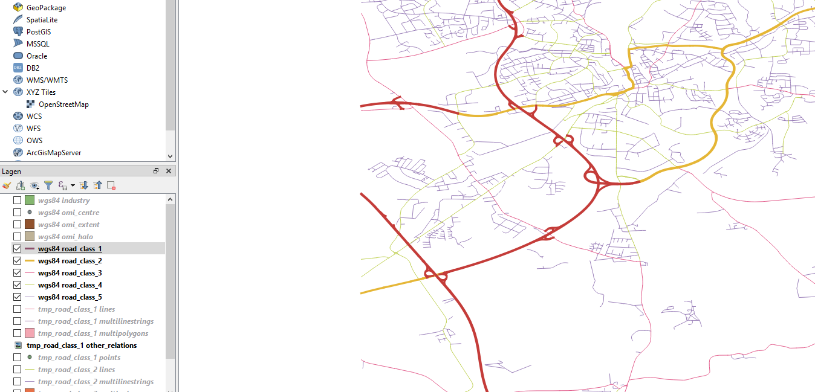
Germany
highway
primary

Slide 53
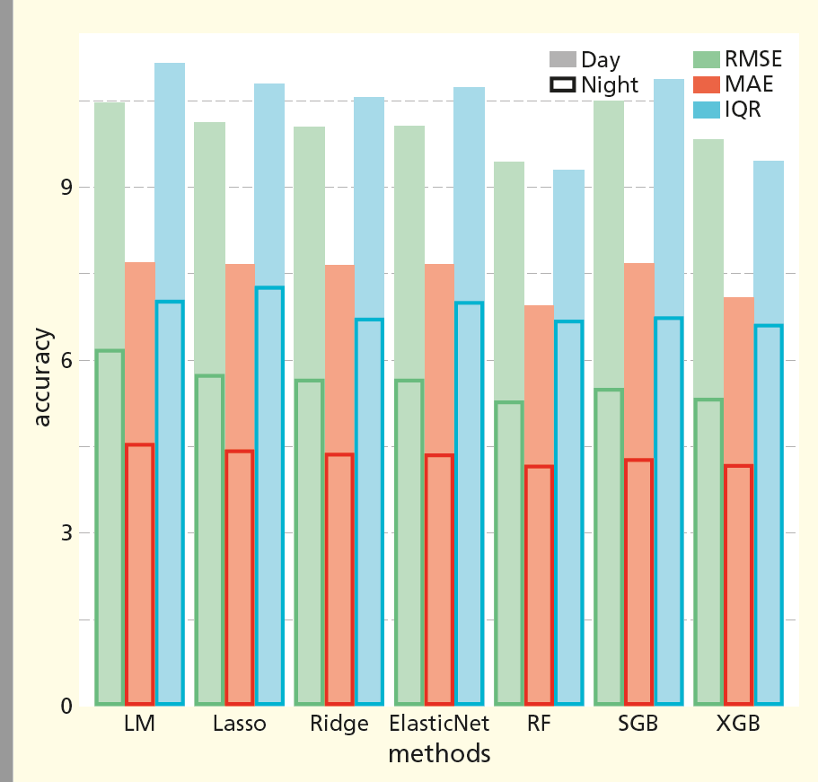
Germany
RMSE: root mean squared error
MAE: mean absolute error
IQR: interquartile range
LM: Multiple linear regression
RF: random forest
SGB: Stochastic gradient boosting
XGB: xgboost

Slide 54
Important emition-related variables
National model of Germany
Ranked top 20 by Random Forest Primary road 25m, 50 m, 100 m Local road 25m, 50 m, 100 m, 300 m Ranked top 20 by XGBoost Primary road 50 m, 100 m Highway 50 m Local road 25m, 50 m, 100 m, 300 m Selected by LASSO Primary road 25m, 50 m, 100 m Highway 50m, 100 m Local road 100 m, 300m
Global model
Ranked top 20 by Random Forest* Primary road 50 m, 100 m Ranked top 20 by XGBoost Primary road 50 m, 100 m Highway 100 m Local road 25 m, 50 m, 100 m Selected by LASSO Primary road 50 m, 100 m Highway 50 m, 100 m Local road 25 m, 50 m, 100 m
*Highway 100 m ranked 26

Slide 55
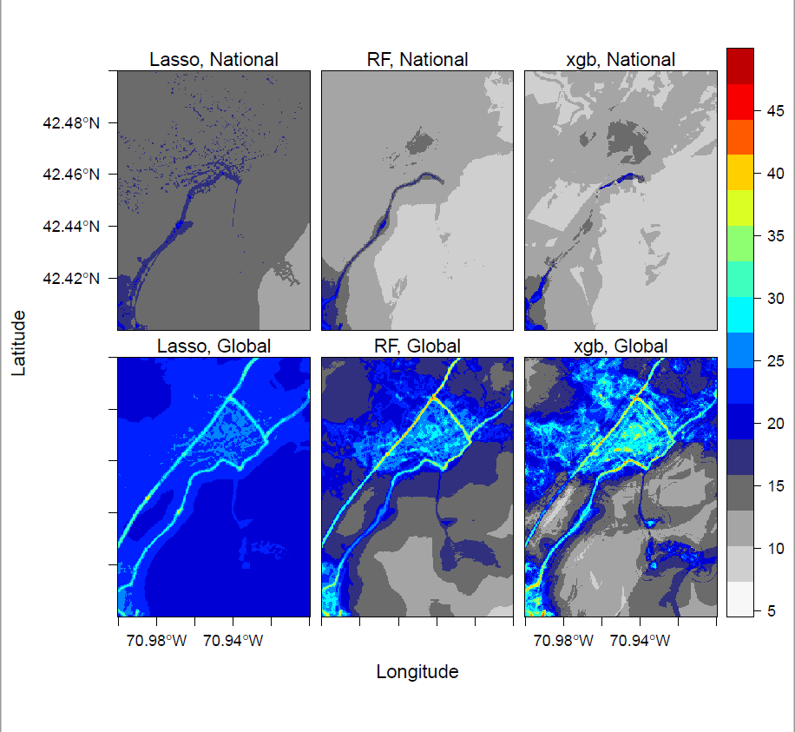
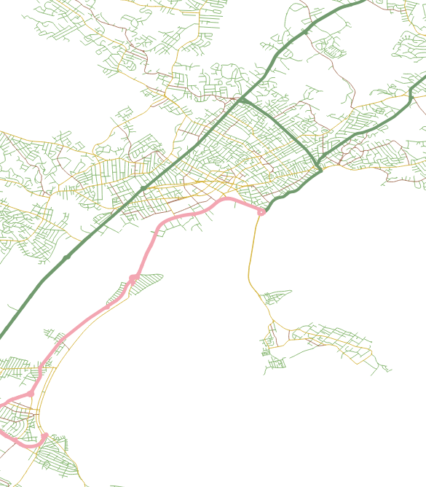
US
primary
highway

Slide 56
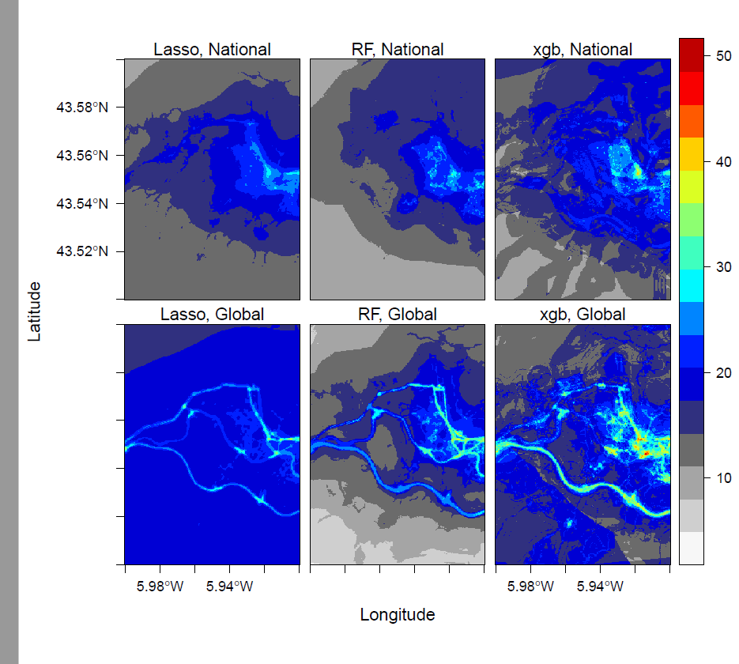
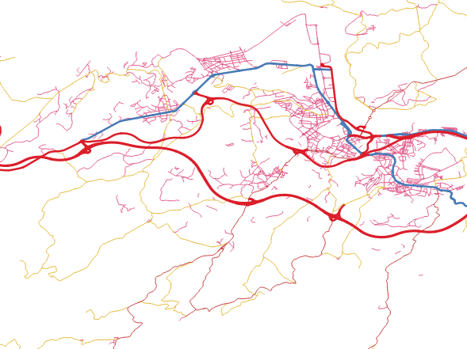
Spain
primary
highway

Slide 57
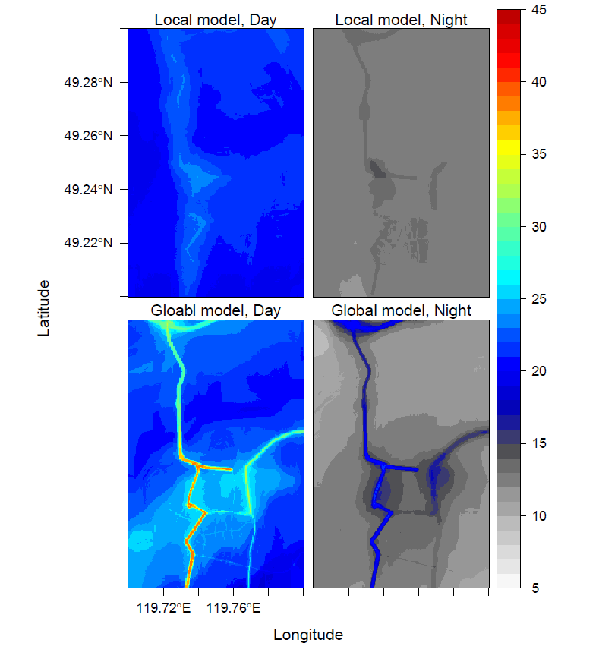
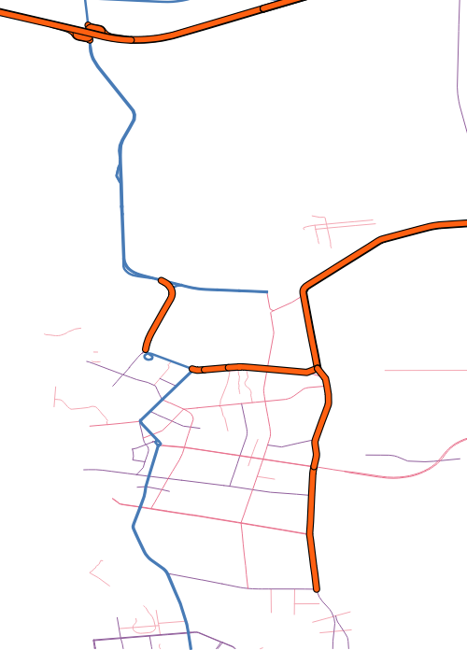
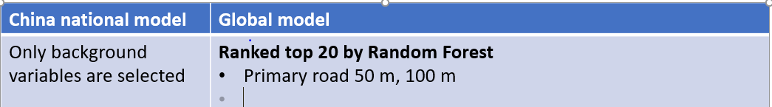
Random Forest
Prediction: China
primary
highway

Slide 58
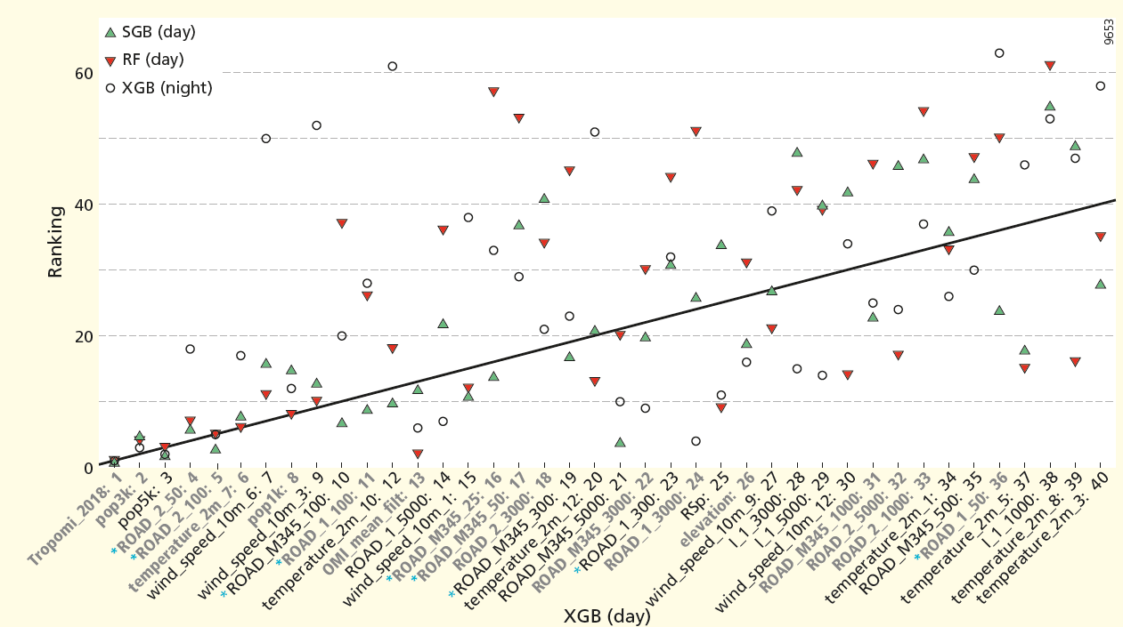
Variable importance
ROAD_M345: secondry and local roads
Pop_: population ROAD_2: primary roads
Global model

Slide 59
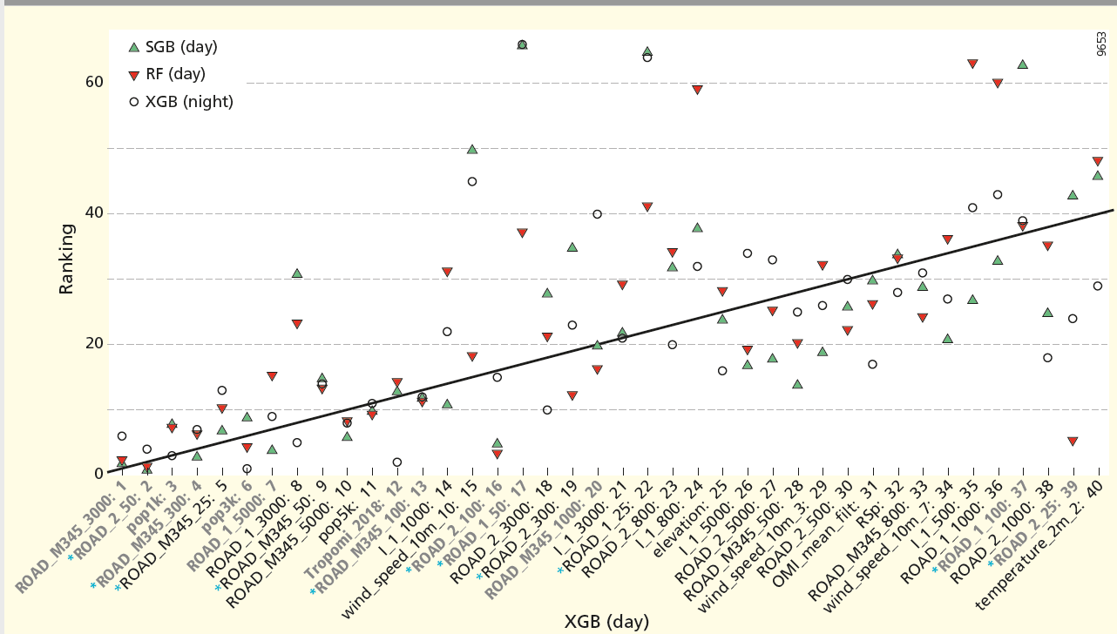
Variable importance
ROAD_M345: secondry and local roads
Pop_: population ROAD_2: primary roads
Germany

Slide 60
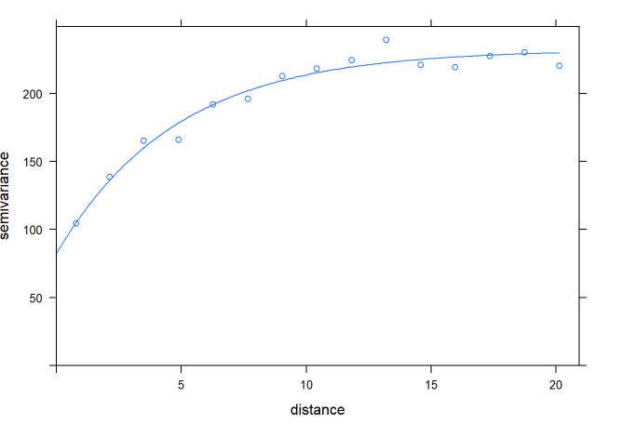
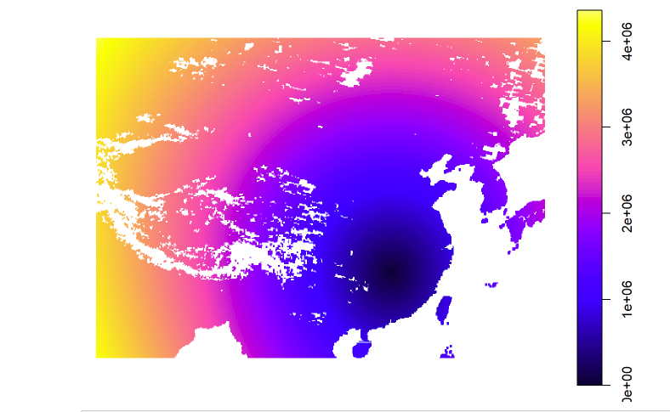

Using random forest for Geostatistic-like interpolation
http://rpubs.com/menglu/473973

Slide 61
Road length | https://www.openstreetmap.org/
Industrial area | https://www.openstreetmap.org/
Population | http://www.integrated-assessment.eu/eu/index.html
Elevation | https://www2.jpl.nasa.gov/srtm/
Wind speed | https://confluence.ecmwf.int/pages/viewpage.action?pageId=74764925
Temperature | https://confluence.ecmwf.int/pages/viewpage.action?pageId=74764925
TROPOMI | http://www.tropomi.nl
NO2 Surface product | http://fizz.phys.dal.ca/~atmos/martin/?page_id=232
OMI | https://mirador.gsfc.nasa.gov/cgi-bin/mirador/presentNavigation.pl?tree=project&dataset=OMNO2d.003&project=OMI&dataGroup=L3_V003&version=003&CGISESSID=57642d429543194f1007d9b91bfab0ae

Slide 62
Hyperparameters
nrounds:
Controls the maximum number of iterations.
Tuned by CV
Eta:
Controls the learning rate,
It must be supported by increase in nrounds.
max_depth:
It controls the depth of the tree. Larger data sets require deep trees to learn the rules from data.
Tuned by CV
Gamma:
Controls regularization (or prevents overfitting).
Higher the value, higher the regularization. Regularization means penalizing large coefficients which don't improve the model's performance.
If you see train error >> test error, bring gamma into action.
Norms:
L1 norm (alpha) and L2 norm (lambda)

Slide 63

Buffered predictors
25 m buffer
1000 m buffer
Notes:
x

Slide 64






Convolution and deconvolution

Slide 65

Remote sensing measurements: OMI (Ozone Monitoring Instrument)
Date of Launch | 15 July 2004
At nadir 13 km × 24 km
NO2, SO2, BrO, OCIO, O3 (36 km × 48 km)
Spectral bands: ultraviolet and visible (270 to 500 nm)
Zoom in mode 13 km× 12 km
Daily global coverage

Slide 66


Tropomi: Sentinel 5p
Feb 2018 to Jan 2019

Slide 69




Control overfitting: Ridge and Lasso regularization
Ridge:
L2 norm
$$ypred$$
Lasso:
L1 norm

Slide 70

Tropomi Vs. OMI
Souce [3]

Slide 73


Bias-variance trade-off
All algorithms are affected by bias-variance trade-off

